Slide 1





















GARBAGE SEGRIGATION AND BIN LEVEL DETECTION

Slide 2






INTRODUCTION
The main objective of this project is to separate wet and dry waste automatically using sensors and Arduino.This system helps to reduce manual work in waste segregation and improves cleanliness.The moisture sensor detects whether the waste is wet or dry, and the servo motor directs the waste into the correct compartment.The project provides an efficient and eco-friendly waste management solution.

Slide 3

PROBLEM STATEMENT
=> Manual garbage segregation takes more time and effort.
=> Mixing wet and dry waste causes pollution and bad smell.
=> Improper waste disposal affects the environment.
=> Existing systems require human involvement for waste separation.

Slide 4
PROPOSED SOLUTION
=> Use a moisture sensor to detect wet and dry waste.
=> Arduino processes the sensor values automatically.
=> Servo motor rotates towards the correct compartment.
=> Wet waste goes into the wet bin and dry waste goes into the dry bin.
=> The system reduces human effort and improves waste management.

Slide 5

COMPONENTS USED
=> Arduino UNO
=> Ultrasonic Sensor (HC-SR04)
=>Moisture Sensor
=>Servo Motor (SG90)
=> Breadboard
=>Jumper Wires
=> Power Supply / Battery
=>Cardboard Dustbin Model

Slide 6
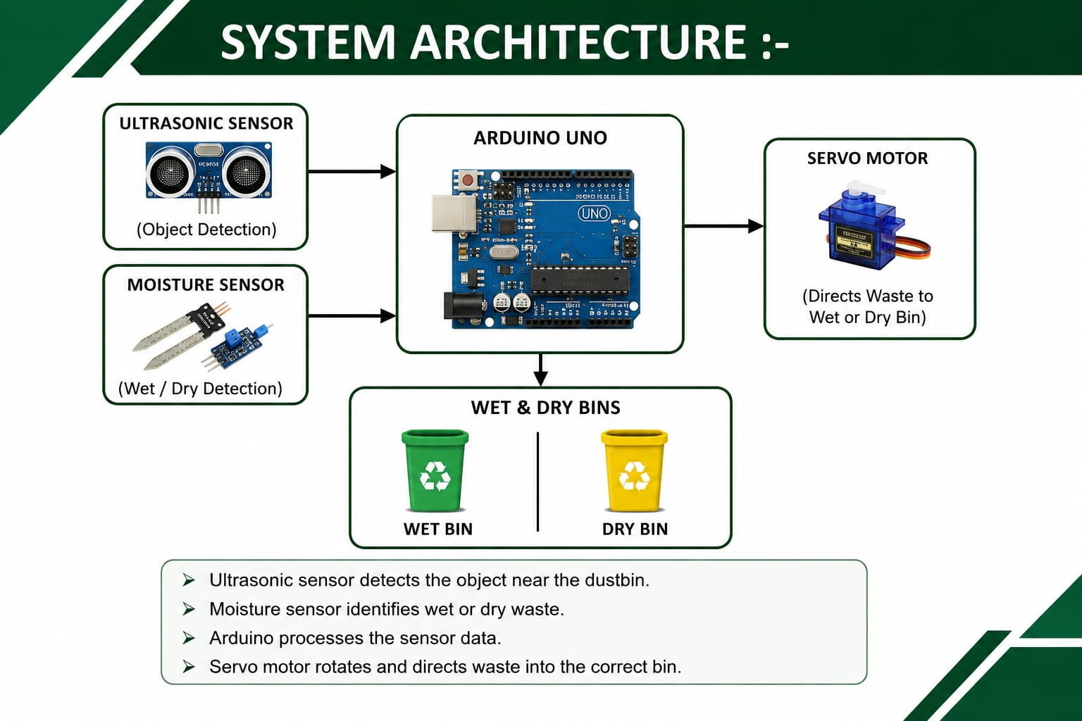

Slide 7
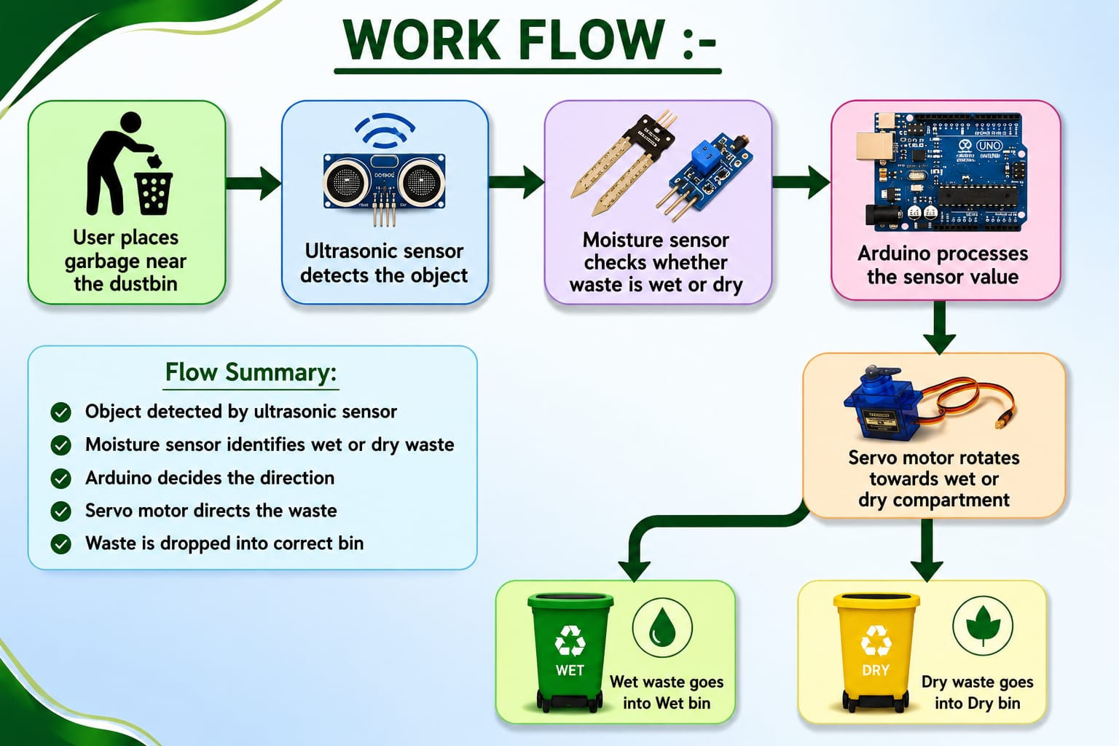


Slide 8
PROGRAMING & IMPLEMENTATION
=> The project is programmed using Arduino IDE and Embedded C language.
=> Arduino continuously reads the values from ultrasonic and moisture sensors.
=> Based on the moisture value, the servo motor rotates accordingly.
=> The complete process works automatically without manual operation.

Slide 9
RESULT AND TESTING
=> The system successfully separated wet and dry waste.
=> Moisture sensor detected the waste correctly
=> Servo motor rotated properly based on sensor values.
=> The project worked efficiently during testing.

Slide 10
ADVANTAGE
=> Reduces manual effort in waste segregation.
=> Improves cleanliness and hygiene.
=> Eco-friendly waste management system.
=> Simple and low-cost project.
=> Easy to use and maintain.

Slide 11
LIMITATIONS
=> Sensor readings may vary for some materials.
=> Requires continuous power supply.
=> Moisture sensor performance may reduce over time.
=> Suitable mainly for small-scale applications.

Slide 12
FUTURE ENHANCEMENTS
=> Add GSM alert system.
=> Add IoT monitoring using mobile application.
=> Improve segregation using AI and image processing.
=> Increase the number of waste categories.

Slide 13
CONCLUSION
This project provides an effective method for automatic waste segregation.
It reduces human effort and helps maintain cleanliness.
The system is simple, cost-effective, and environmentally friendly.
=> Overall, it is a smart solution for modern waste management.

Slide 14


THANK YOU
TEAM MEMBERS
ABIRAMI B
KOLAMGIRI SURESH
KOWSALYA R
KRISHNA PRIYA RS
MOHAMED GHOUSE U
NABIL BASHA A

